Slide 1
Secrets Steps for a Successful Remodeling
Joseph Dileo

Slide 2
Step 1
Selecting the right contractor for your venture is integral. Focus on somebody who communicates well, reacts to messages and brings in an auspicious way, assists with configuration, approach and execution, and has broad experience alongside dependable referrals. Make beyond any doubt they are authorized and reinforced.
At the point when contrasting contractors, be sure you are contrasting one type with it's logical counterpart.

Slide 3
Step 2
Throughout the building and remodeling process, you will be making many decisions. Make decisions early and often.
Delayed decisions and changes delay the work schedule. Also, avoid being a distraction to your project time is money.

Slide 4
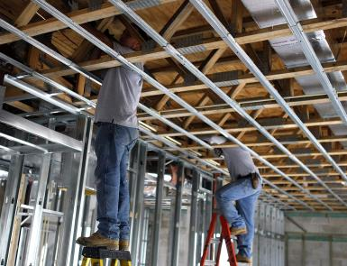
Step 3
Depending upon the extent of work, make arrangements to be out of the house for a timeframe. Projects , for example, sanding floors, furnace close off for HVAC work and huge augmentations may oblige you to move; make sure to keep youngsters and pets out of mischief's way. There will be clean and noise, no ifs ands or buts.

Slide 5
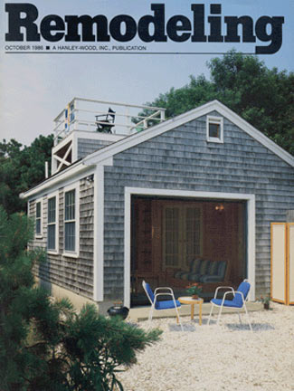
Step 4
Get thoughts for your configuration by experiencing photographs on Houzz, Pinterest and magazines. Any direction you can go along to your temporary worker with respect to the look you need will assist the procedure and breath life into your vision.

Slide 6
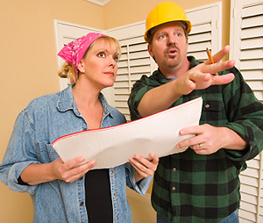
Step 5
Expect the unexpected. Before you start your remodel, work out a possibility reserve for additional items; we prescribe 10 to 15% of the aggregate undertaking. There might be unexpected costs that surface outside anybody's ability to control. You never recognize what's behind the dividers until you open them.

Slide 7
Joseph Dileo
500 N. Rainbow Blvd. #300 Las Vegas, NV. 89107 Phone No - 702-255-8700

