Slide 1
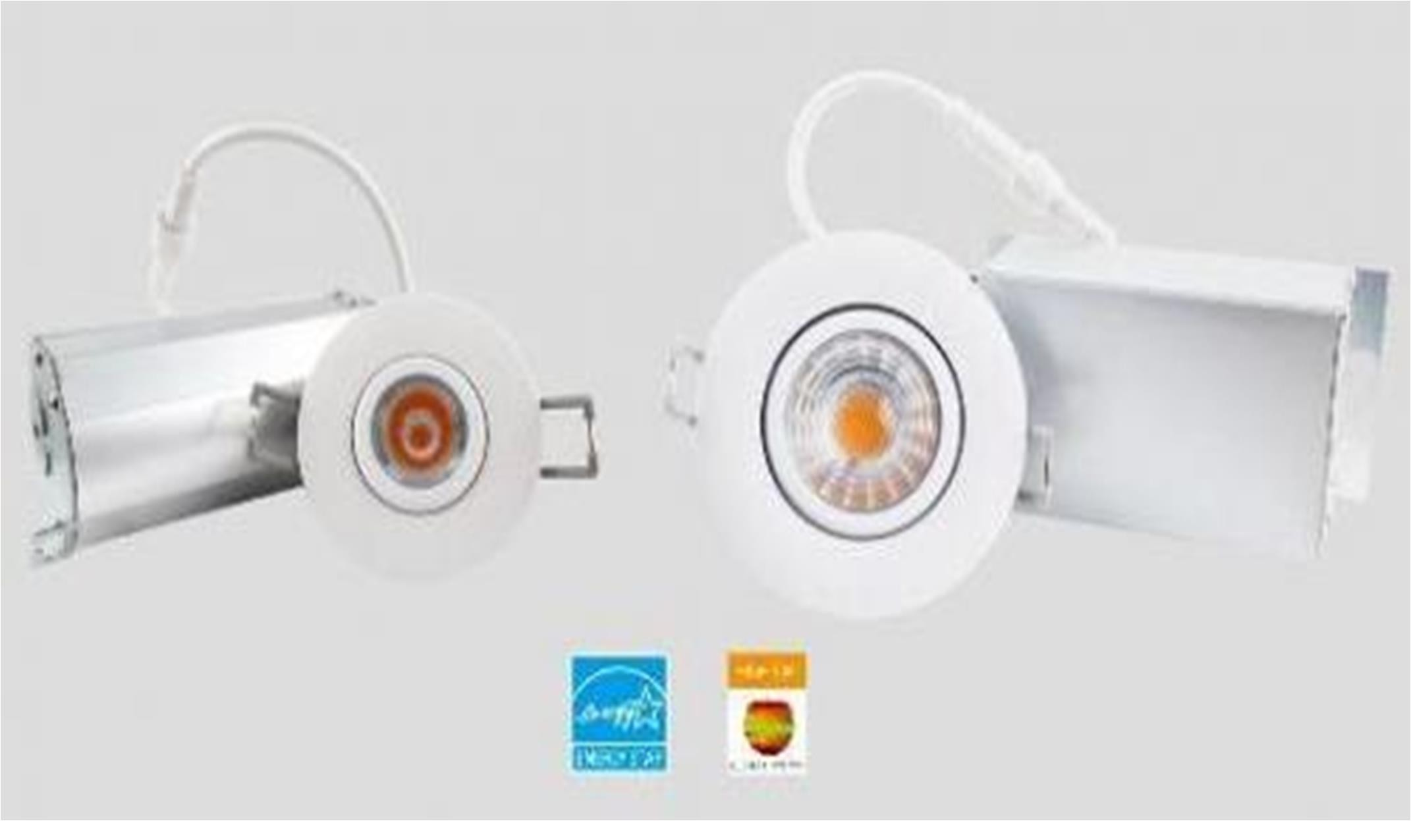
GREEN CREATIVE releases miniFIT Gimbal, a 1” and 2” adjustable aiming mini downlight
SAN BRUNO, CA, 27 March 2019 -- GREEN CREATIVE, your partner for professional lighting solutions, proudly announces the launch of the 1” and 2” miniFIT Gimbal luminaires.
“miniFIT gimbals offer up to 600 lumens in a compact form factor. In addition, the fixture’s easily adjustable nature allows for them to be installed in any orientation in the ceiling to graze textured walls, highlight artwork, or emphasize architectural features” said Chad McSpadden, product Manager at GREEN CREATIVE.
The gimbals come with a 38° beam acrylic optic, producing a consistent, precise beam of light. They rotate 360° and tilt up to 30°, giving you the ability to get the right light in the right place! These features
make it the ideal companion for any residential, retail and
hospitality applications.
The luminaires come in 90 CRI minimum, last 50,000 hours and come in 2700K, 3000K, and 4000K CCT. MiniFIT Gimbals are ENERGY STAR certified, JA8 compliant, as well as IC and Air- tight rated.
Detailed information and data sheets for the 1” and 2” miniFIT Gimbals are available at the GREEN CREATIVE website.
These products are available through GREEN CREATIVE distributors and are ready to ship from the company’s west, central and east coast distribution centers. For more information on where to purchase these products near you or how to become a distributor, please contact GREEN CREATIVE at: sales@greencreative.com or (866) 774-5433.
About GREEN CREATIVE
GREEN CREATIVE is a major solid-state lighting development and manufacturing company based in the San Francisco Bay area. The company specializes in providing high quality lamp, downlight, track and fixture lighting solutions for the commercial
& residential market. GREEN CREATIVE is fully integrated with strong R&D capabilities to constantly offer the latest technology available. For more information

Slide 2
on GREEN CREATIVE please visit www.greencreative.com. For all of the latest updates follow GREEN CREATIVE on Facebook, Twitter and LinkedIn or YouTube.
Contact:
David Weinberg GREEN CREATIVE
1111 Bayhill Drive, Suite 315 San Bruno, CA 94066
Tel / Fax: (866) 774-5433
info@greencreative.com https://greencreative.com/

