Slide 1
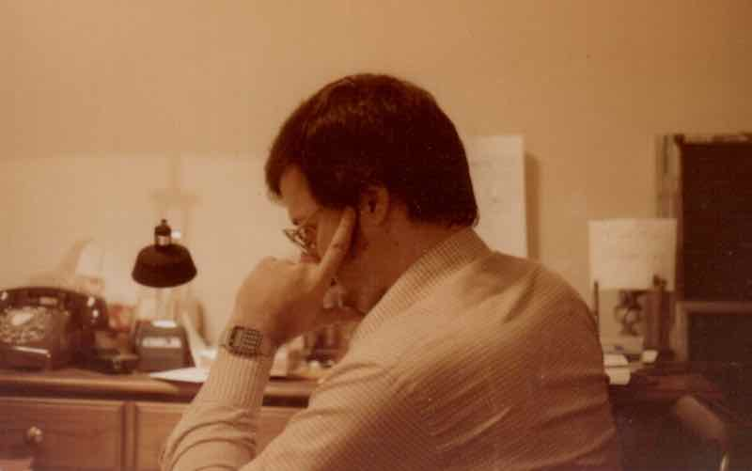
Hire Lernin’
An Idealist’s Quest through the
Realm of for-Profit Education
A Novel
Victor D. López

