Slide 1
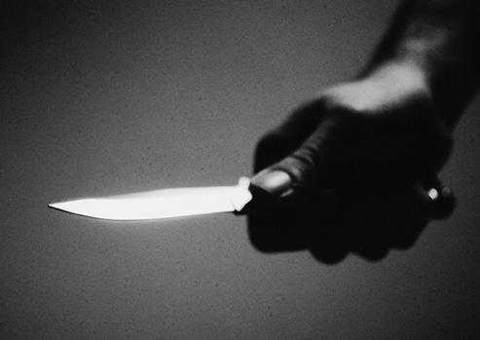
HATE ME KILL ME

